Slide 1
Campus Wide Soft Plastics Recycling
Ryan Woodward, Joel Cohen, Gareth Marriott, Bowu Shi

Slide 2
Table of Contents
Project Background
Client Context
Problem Statement
Benefits
Timeline
Work Completed
Work Remaining
Expectations for Completion

Slide 3
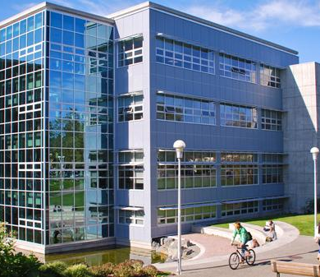
Client Context
The University of Victoria's Waste Reduction Supervisor & Coordinator is requesting proposals for sustainable solutions for waste reduction.
The goal is to increase landfill waste diversion by 82% in 2020/21

Slide 4
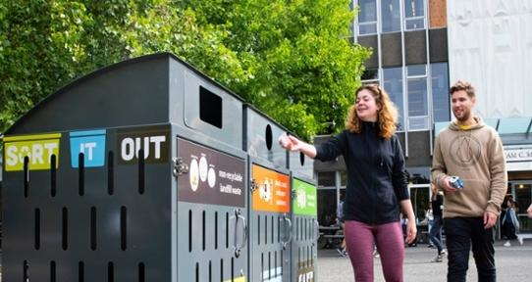
Project Background
This proposal provides a plan to implement campus-wide soft plastics recycling across the University of Victoria in an attempt to lower Uvic’s plastic landfill waste.
The only option available to students and faculty to recycle soft plastic is a single “Expanded Recycling Station” located in the Student Union Building. Having only one location on campus for disposing of soft plastics provides barriers to recycling that aren't faced when recycling hard plastic. Adding soft plastic recycling to some or all of these kiosks could be an effective way to increase UVIC's soft plastic waste diversion rate to something similar to hard plastic.

Slide 5
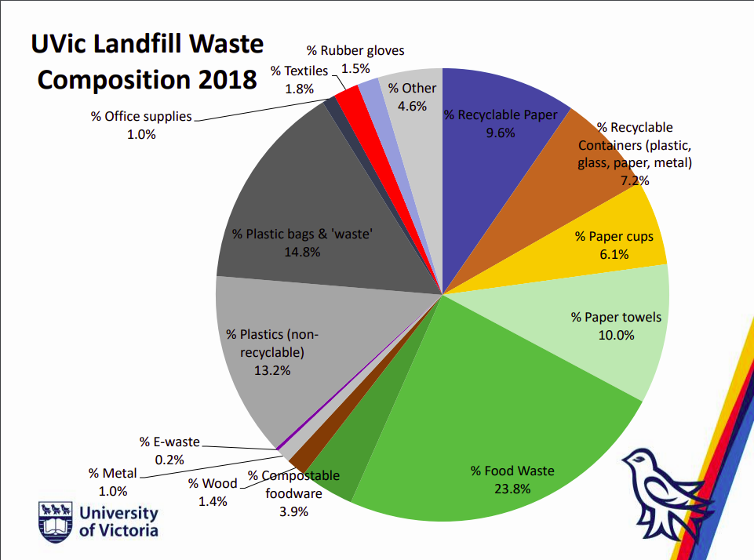
Problem Statement
University of Victoria’s 2020/21 sustainability action plan intends to increase the landfill waste diversion rate to 82%.
The sort-it-out stations installed in 2019 do not have a compartment to recycle clean soft plastics nor clean styrofoam.
The stations recommend placing these items in the landfill waste bin. This means that 100% of the sort-it-out stations will fail to divert soft plastics and styrofoam from the landfill.

Slide 6
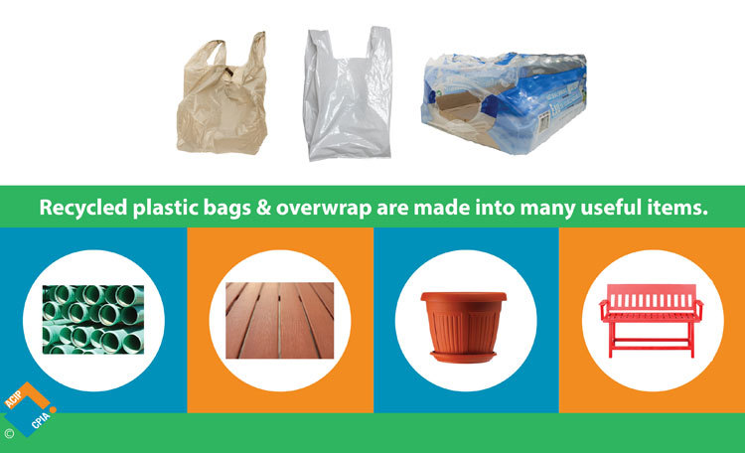
Benefits
The proposed action plan will
Help meet the waste diversion rate of 82%
Help achieve UVIC’s ultimate zero waste goal
Educate the community about soft plastics recycling

Slide 7
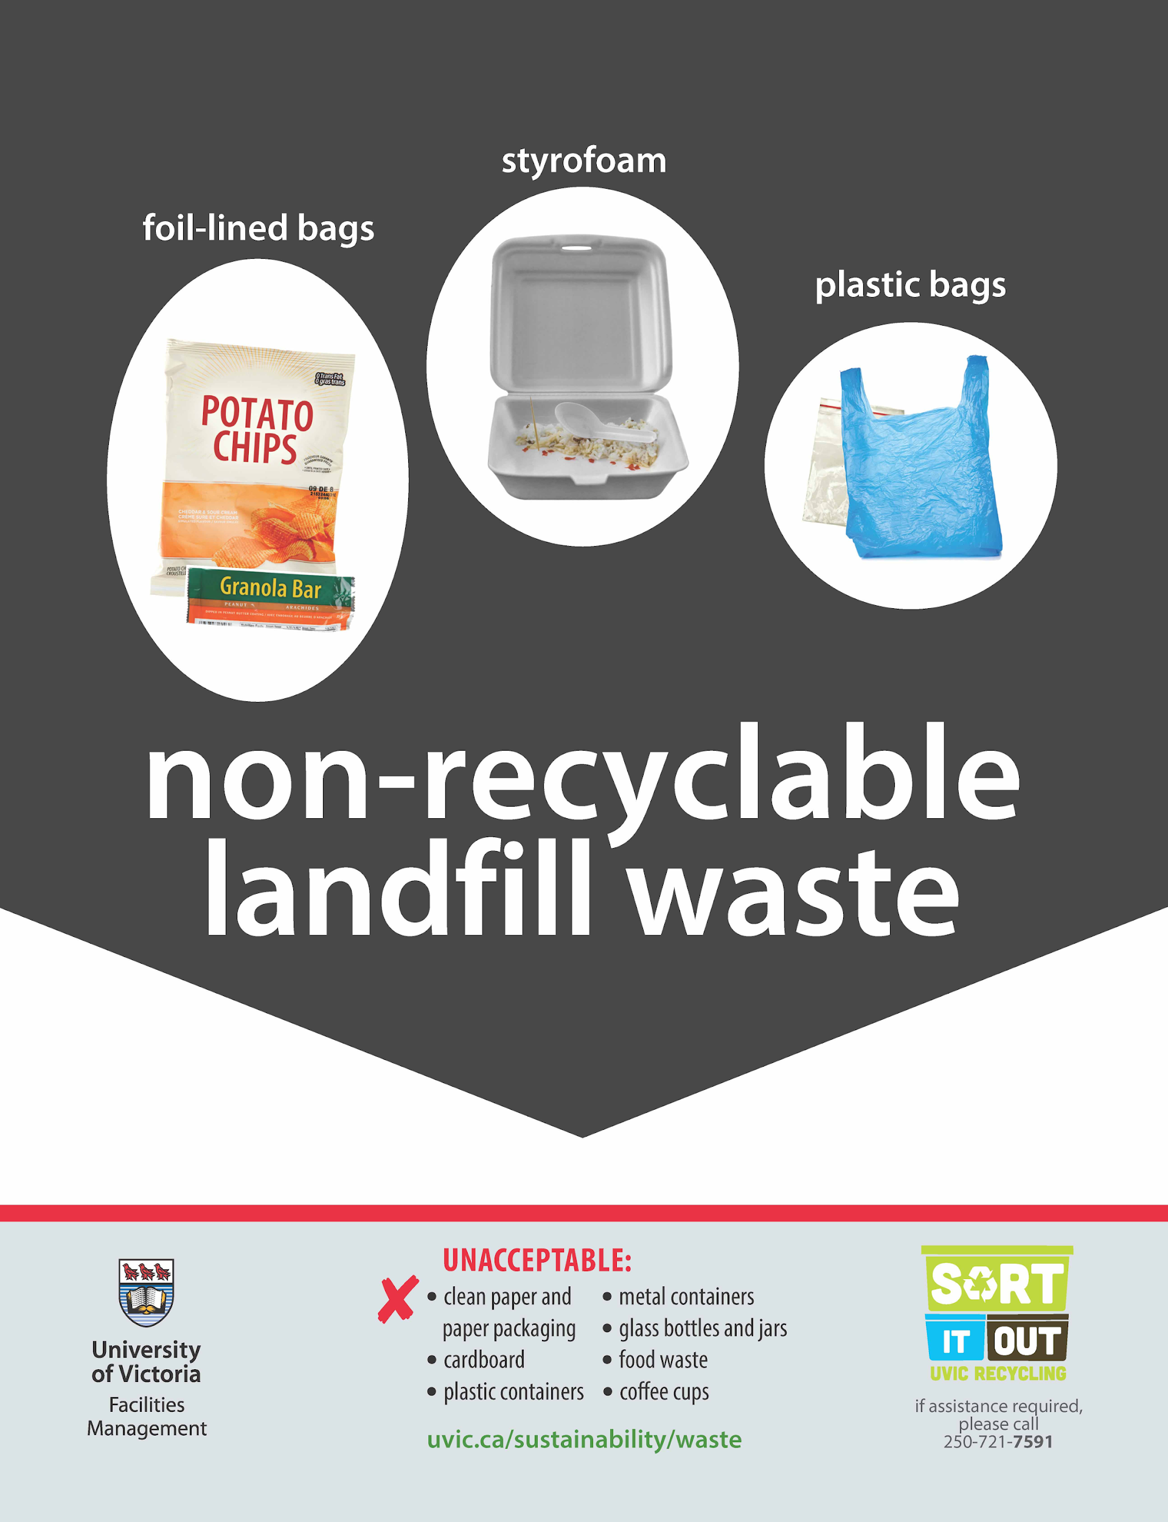
Objectives
Introduce Soft Plastic recycling bins to high traffic Sort It Out Stations with plans to add more stations if successful
Eliminate Styrofoam and Plastic Bags from landfill waste

Slide 8
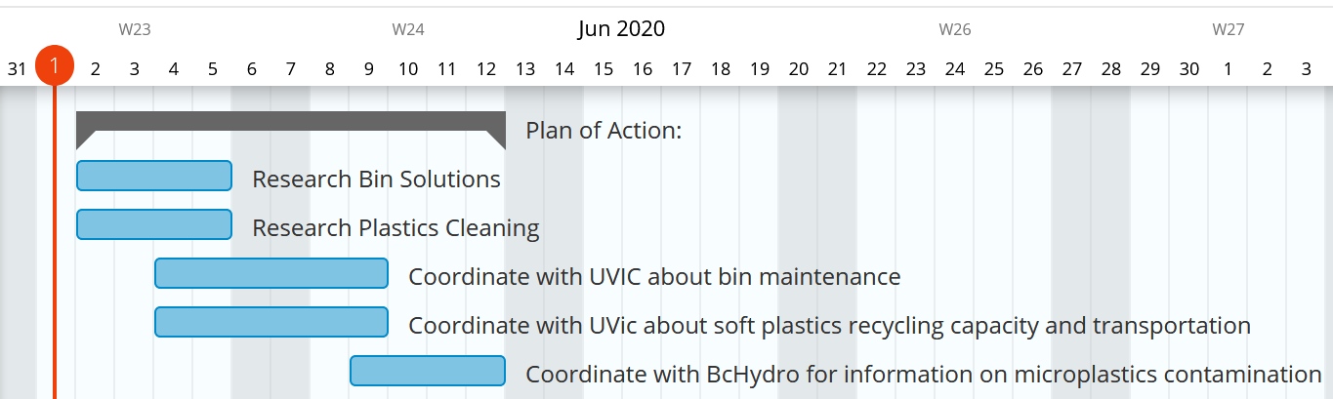
Timeline

Slide 9



Work Completed
Investigated of the shelf soft plastic cleaning solutions from industrial machine suppliers
Sent email to the Recycling Council of BC, and examined commercial recycling solutions in Victoria
Received response from facilities about bin cost, waste storage capacity, and transportation

Slide 10
Problems
Upon searching sites such as directindustry.com we found no reasonably priced commercial solution for the cleaning of soft plastics.
Lack of response from BC Hydro regarding acceptable levels of microplastic contamination

Slide 11
Work Remaining
Liaison with Emterric, Uvic's recycling transportation solution, and determine an adequate, scalable solution for soft plastic cleaning. Expected completion date: Friday, June 19th
Finish assembling report on campus-wide soft plastics reycling

Slide 12
Expectations for Completion
We would propose installing a small number of bins initially to get an idea for how much each bin increases the volume of soft plastics diverted, then increase the storage and transportation capacity accordingly.
This project is looking to stay within the budget, cleaning solutions dependent.

